Slide 1
Business Email Compromise Workshop Symantec An Industry Viewpoint on Mitigation and Threat Landscape
Yvonne Dresser
Product Strategy, Symantec
December 14, 2017
Notes:
Good morning everyone, my name is Yvonne dresser with Symantec, and I am very pleased to be here at this Business Email Comprise workshop. I am joined by 2 other Symantec folks, Raleigh Burns & Jamille Kelly (both are Principal System Engineer for Public Sector Cyber Security).
A little about myself, I am part of the product strategy and marketing team for the email and endpoint security product lines at Symantec and have occupied this role for about a year. My background and experience for most of my career in product marketing and product management roles in the end user computing and endpoint data security space – including desktop and app virtualization, endpoint backup an now endpoint and email security.
It’s my hope that at end of this presentation you leave better informed about today’s email based security threats, especially, Business email compromise, and understand best practices and available technologies worth considering for your organizations.

Slide 2
Agenda
1
Email Threat Landscape
2
How Business Email Compromise Works
3
Best Practices
4
The Symantec Solution
5
Q & A
Notes:
Over the next 40 minutes or so, the following topics will be covered including an overview of the email threat landscape – what’s popular today and how these malicious threats work, I will break down how BEC works and highlight key indicators or triggers of a BEC attack. I will spend some time discussing best practices from a people, process technology perspective. Then wrap with a quick overview of Symantec’s email security solution and open up the session with a question and answer segment.

Slide 3
Email Threat Landscape
1

Slide 4
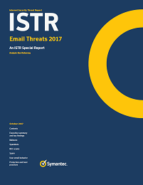
Internet Security Threat Report (ISTR) Special Report
“The latest ISTR special report, Email Threats 2017, casts a light on a threat landscape where attackers are actively spreading malicious threats, BEC scams, and a variety of spam through email.”
www.symantec.com/connect/blogs/users-encounter-threats-through-email-twice-often-other-infection-vectors
Notes:
Symantec Research labs is Symantec’s global research organization that plays a leading role in developing and commercializing numerous cutting-edge technologies across Symantec’s business areas. Symantec’s security research lab also analyzes and reports annually on a broad array of cybersecurity topics including this recently published email threats report, which I encourage you to read to truly understand the scope and techniques of today’s modern email threats. In the meantime, I have pulled a number of email threat topics I would like to share with you.

Slide 5
Email Attacks Becoming More Targeted and Sophisticated
55%
61%
$5B+
Increase in
spear phishing attacks
of organizations hit by a ransomware attack in 2016
Lost to Business Email Compromise (BEC) scams over last 3 years
Sources: 2016 Internet Security Threat Report | Volume 21, CyberEdge Group 2017 Cyberthreat Defense Report, FBI Public Service Announcement, I-050417-PSA (May 2017)
Notes:
And, so to begin, email attacks are becoming more targeted and sophisticated than ever before. Email attacks are increasingly evolving beyond basic spam and phishing emails to highly targeted & advanced email threats such as spear phishing, ransomware, and Business Email Compromise. These threats typically use social engineering to trick vulnerable users and leverage complex techniques to evade detection, such as concealing malicious links, hiding malware in attachments, or using cousin domains to impersonate a legitimate domain.

Slide 6
BEC Scams Continue to Threaten Businesses
BEC Emails Per Organization
8,000
Businesses a month are targeted by BEC scams
5.2
BEC emails a month per targeted organization
Source: Internet Security Threat Report: Email Threats 2017
Notes:
The threat of business email compromise (BEC) scams continues to grow, as does the financial impact of the scam. According to a recent analysis by the FBI, over US$5 billion in losses have occurred between late 2013 and the end of 2016. It’s not just large enterprises that are being targeted either, as businesses of all sizes have reported attempted attacks.

Slide 7
BEC Scams Succeeding Due to Social Engineering
Subject lines carry a sense of urgency, requiring immediate action
Attempting to coerce the recipient to act quickly
The top subject lines are:
Payment (18.9%)
Urgent (10.3%)
Request (8.6%)
Goals of BEC scams:
Financial gain
Exfiltrate sensitive data such as tax information
Source: Internet Security Threat Report: Email Threats 2017
Notes:
First of all, what you must understand is that a BEC scam relies on social engineering instead of malware to extract money or sensitive company information, thus eluding traditional email security technologies and engines.
Looking at the content of BEC scam emails, the dominant motif seen in the subject lines tends to carry a sense of urgency, requiring immediate action, in the hopes that the recipient will be coerced into acting quickly without thinking too much about what it is he or she is being asked to do. In fact, when looking at the top email subject lines seen in emails we have identified as BEC scams, this trend becomes all the more clear.

Slide 8
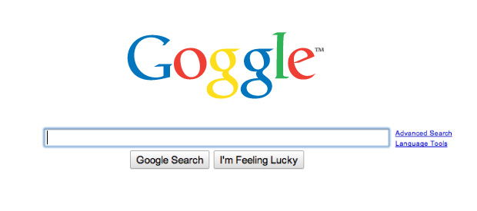
BEC Scammers Are Using Typosquatting to Trick Users
What is Typosquatting?
Domains that look similar to official domain emails they impersonate
Often known as ‘cousin’ or ‘lookalike’ domains
Other Forms
Use a different domain
Add words to the domain
Examples:
Amce_inc.com instead of acme_inc.com
Symanlec.com instead of symantec.com
Acme_inc_sales.com instead of acme_inc.com
4,000
Typosquatted domains for just 100 customers over 90 days
Source: Internet Security Threat Report: Email Threats 2017
Notes:
One trend that has become more prominent in the BEC landscape is typosquatting where attackers frequently register domains that look similar to the official email addresses of the organizations they intend to target. The domains may have a character or two misplaced, for instance “amce_inc.com” for the legitimate business, “acme_inc.com.”

Slide 9
Spam
“Two years from now, spam will be solved.” –Bill Gates, January 24, 2004
Between 2011 and 2015 the spam rate has been declining.
The annual spam rate leveled off at 53 percent for 2015 and 2016.
Looking at half-yearly rates, spam rate appears to be climbing back up.
First half of 2017 had a spam rate of 54 percent.
Second half of the year appears to continue this trend.
Source: Internet Security Threat Report: Email Threats 2017
Notes:
The most predictable of annoyances in the email landscape is spam. While it has declined since this infamous quote from Bill Gates, often blocked or relegated to a folder that most users ignore entirely, it still sticks around.
While seemingly in decline, the spam rate continues to comprise more than half of all email traffic. For the first half of 2017, this rate has reached 54 percent and all signs point to a continuation of this upward trajectory.

Slide 10
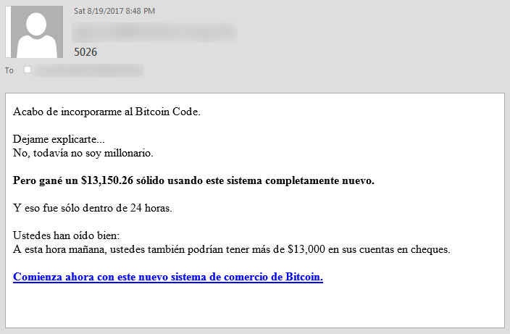
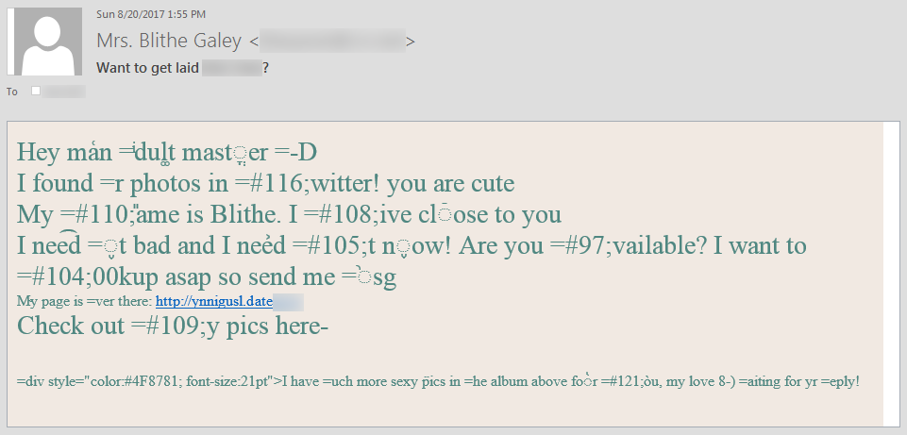
Spam
Increase equates to 11 more spam emails in your inbox each month.
Without spam filters, a business effectively employs two people to manage spam for every 100 employees.
Necurs pump-and-dump stock scams
Gamut and Tofsee advertising scams to collect user credentials
Bitcoin and work from home campaigns enticing recipients into becoming money mules.
Source: Internet Security Threat Report: Email Threats 2017
Notes:
So, what does this increase in spam mean to organizations? It means 11 more spam emails in the mailboxes of your users. And that without strong spam protection, your messaging team could be spending a lot of cycles controlling spam distribution. In terms of types of spam, the most popular types being generated by spambots include;
Pump and dump stock scams where scammers purchase large quantities of low priced stocks. Send out spam advertisements based on an erroneous insider tip predicting the stock will rise shortly and encouraging users to purchase the cheap stock which drives up the stock price. Then the scammers sell the stock once it’s risen.
Advertising of various products such as wonder drugs or dating sites seeking to capture user credentials.
Other scams are looking for ways to launder money from Bitcoin and work from home campaigns. Where the user is asked to convert bitcoin to cash using their personal accounts and then taking a cut.

Slide 11
Email Malware Is Increasingly Targeting Users
Email Users Targeted By Malware Per Month
1 in 9
Users encountered email malware in the 1H of 2017
2X
likely to encounter malware via email than exploit kits
January February March April May June
Source: Internet Security Threat Report: Email Threats 2017
Notes:
The strengths that have made email such a popular communication tool are the same reasons cyber criminals use it to spread their wares. The attackers just fire off a spam message to a target, or group of targets, and that’s it—no need to rely on indirect methods where the target might or might not visit a compromised site or click a malicious banner ad. It is a direct channel to an end user who, if they can be convinced to open an attachment or click a link in the email, can cut a large swath through a variety of network security layers, gaining an attacker access to their intended target.
This direct access to the intended target is reason alone to get businesses to take malicious email seriously. Businesses are regularly targeted by malicious emails. In fact, in the first half of 2017, more than 11 percent of users had at least one malicious email sent to them. That’s one out of every nine email users

Slide 12
Malicious Email per Industry
Wholesale Trade and Mining highest
Utilities and Financials lowest
No sector immune
Source: Internet Security Threat Report: Email Threats 2017
Notes:
Depending on the industry that a given user works within, this number could rise even higher. The percentage of users that will have a malicious email sent to them climbs as high as 23.8 percent in industries such as Wholesale Trade and 22.6 percent in Mining. It’s 18.4 percent in Agriculture, Forestry, & Fishing and more than 18.2 percent in Manufacturing.

Slide 13
User Email Behavior
29 percent of all emails within an organization are widely shared.
Almost two-thirds of these broadly shared emails contain sensitive data.
One out of every nine broadly shared emails that contains sensitive data isn’t encrypted.
Source: Internet Security Threat Report: Email Threats 2017
Notes:
According to the latest data presented in the Symantec Shadow Data Report, 29 percent of all emails within an organization are widely distributed throughout that organization, shared externally with external contractors and partners, or shared with the public. This in-and-of-itself isn’t a huge issue, and is often a necessity when doing business.
The risk associated with such emails comes into play when sensitive data is involved.
Sometimes it is necessary to share these various types of data widely, and email can be a good way to distribute it quickly. This is generally fine, so long as the sender implements encryption. The good news is that overall there does appear to be a definitive move towards the adoption of encryption when it comes to transmitting email.
In addition to the rapid adoption of TLS, organizations need to do more to ensure the actual messages and content are encrypted by adopting encryption standards such as S/MIME and PGP.

Slide 14
Attackers Distributing Malicious Attachments Via Email
Malicious emails using social engineering in subject lines & message bodies to trick users
The top themes are:
Billing or Invoices
Package Delivery
Scanned Documents
Attackers using downloaders to deliver malware. Why?
Downloading a payload separately helps evade email security
C&C server can send localized or no payloads
Easy to change the final payload in case of detection
74%
of malicious emails contained attachments
53%
of attachments were scripts or Office files with macros
Source: Internet Security Threat Report: Email Threats 2017
Notes:
The vast majority of malicious emails attempt to entice the user through socially engineered subject lines and message bodies in order to trick the user into opening a malicious attachment. The top three themes centered around billing, package delivery, and scanned documents—all topics where an email attachment wouldn’t appear out of the ordinary. Over the years, to improve their chances of successfully delivering their malware and evading email security, attackers have moved from distributing their payloads outright and come to rely on downloaders. Generally speaking, downloaders are small programs or scripts that, when run, can download further files. In the first half of 2017, 53.3 percent of malicious attachments were scripts or macro-loaded office files, designed to download further malicious software once they are run by the user.

Slide 15

Growing Usage of Malicious URLs in Email Attacks
URL Email Malware Rate
1 in 6
Malicious emails contain an URL instead of an attachment
Source: Internet Security Threat Report: Email Threats 2017
Notes:
Another tactic used by attackers is to forego attachments entirely and include a link to a malicious website instead. This is not a new technique. In the first half of 2017, the proportion of URL-laden malicious emails was one in six. This is the highest rate seen since November 2014.

Slide 16
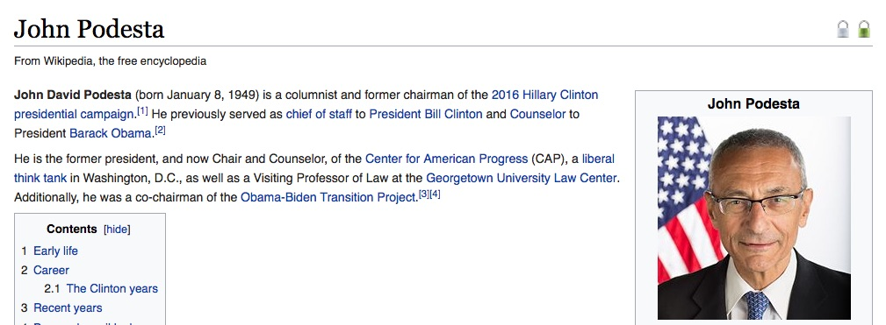

Real World Example
Notes:
Lets take a look at a real world spear phishing attack that used a malicious URL delivered via email that was made very public last year. In 2016 John Podesta was the Chairman of the Hillary Clinton presidential campaign.

Slide 17
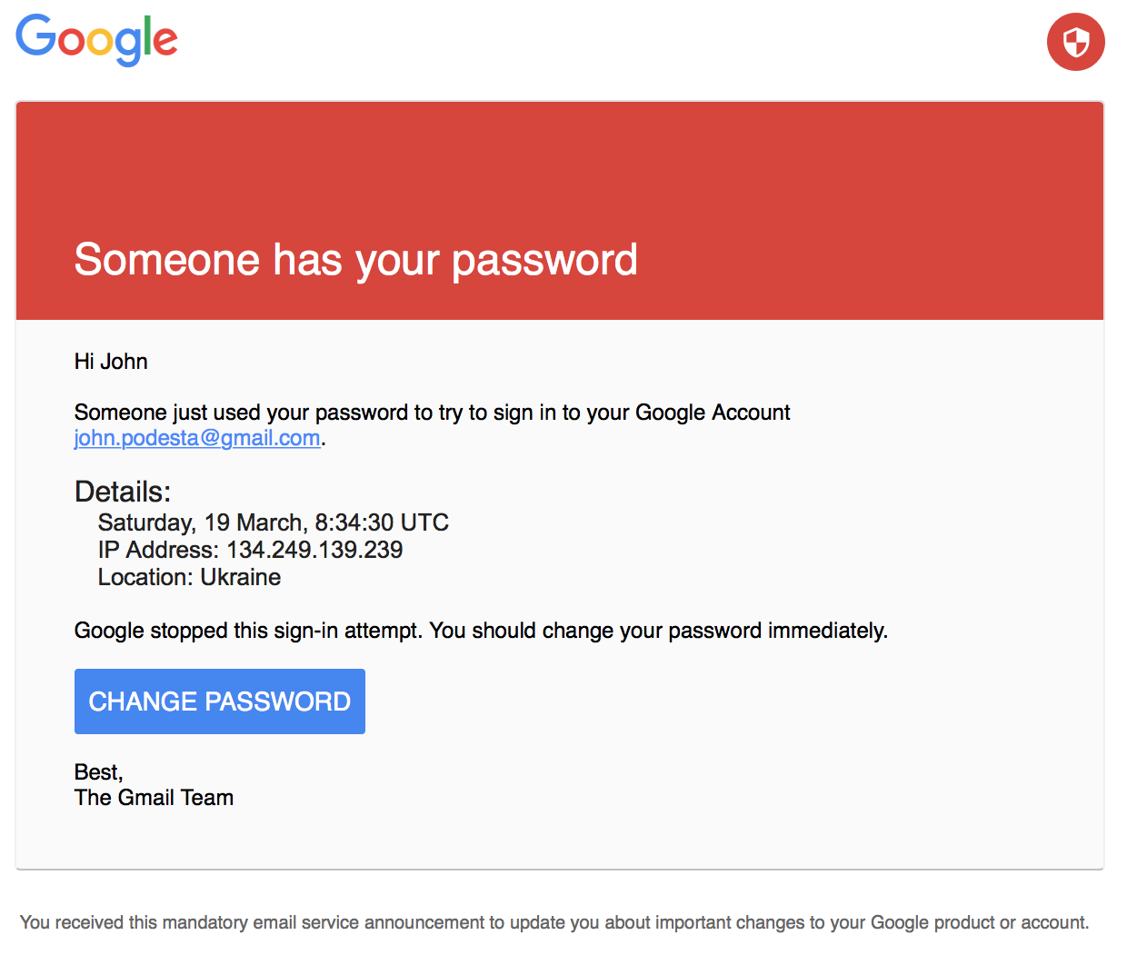
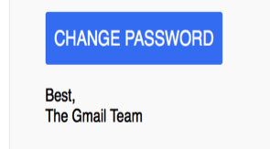
Anatomy of a Targeted Phishing Attack
The branding looks consistent (Google logo, shield logo)
The email is addressed to the recipient (not “Dear Sir”)
The English is not broken
Notes:
In what may be the world’s most famous targeted spear phishing attack, the Gmail account of John Podesta was compromised. According to the FBI, this spear-phishing email was sent to campaign chairman John Podesta’s email account on March 19, 2016.
The email was crafted to appear as though it originated from an official Gmail administrative account. The branding looks consistent (Google logo, shield logo). The email is addressed to the recipient (not “Dear Sir”). The English is not broken. It appears to be very well crafted.
.

Slide 18
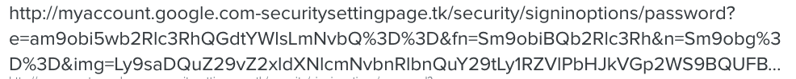

Anatomy of a Targeted Phishing Attack
myaccount.google.com
-securitysettingpage.tk
http://bitly.com/gblgook
Notes:
We know that best practice is to hover your mouse over a link to view the real URL of a link. This email used a shortened URL which obfuscated a malicious URL.
Even if an end-user could see the full length of the URL, the true domain is obfuscated. At first glance, the domain appears to be myaccount.google.com. But if you look closely you can see that the actual domain is myaccount.google.com-securitysettingpage.tk That’s not Google. But it’s a lot more social engineering than a cyber-criminal puts into a basic phishing attack.

Slide 19
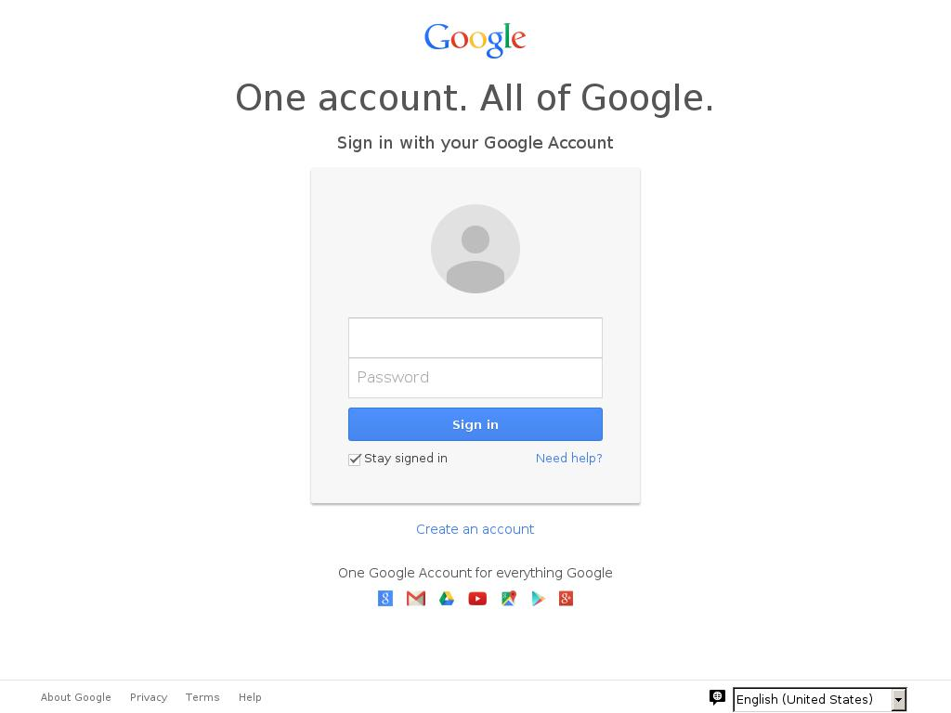
Anatomy of a Targeted Phishing Attack
The login page looks identical to the actual login page (HTML was cloned)
Once the user submits the username/password combination, it doesn’t matter what happens next
Typically, the phishing page redirects users back to Google.com
Notes:
Once clicked, the victim, in this case, John Podesta, is directed to a fake password reset page masquerading as a legitimate Gmail account reset page. The login page looks identical to the actual login page (in fact the HTML was cloned). Once the user submits the username/password combination, it doesn’t matter what happens next.
Typically, the phishing page redirects users back to Google.com
No malware or exploits were needed to perform the attack. Instead, simple social engineering was used to obtain a password.

Slide 20
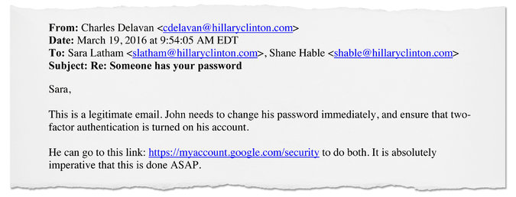
Anatomy of a Targeted Phishing Attack
John needs to change his password immediately, and ensure that two- factor authentication is turned on his account.
This is a legitimate email.
He can go to this link: https://myaccount.google.com/security to do both. It is absolutely imperative that this be done ASAP.
Notes:
But luck, or a typo also played its part in the success of this attack.
Mr. Podesta asked about the email he received. He didn’t just click it. And IT sent back a response. You can see that the advice is good. He was urged to change his password. HE was urged to use 2-factor authentication. All good.
He was given the correct URL to go to.
But the message contained a single typo. The word NOT was left out. This changed the meaning of the message. And Mr. Podesta clicked on the link in the email.

Slide 21
How Business Email Compromise Works
2

Slide 22
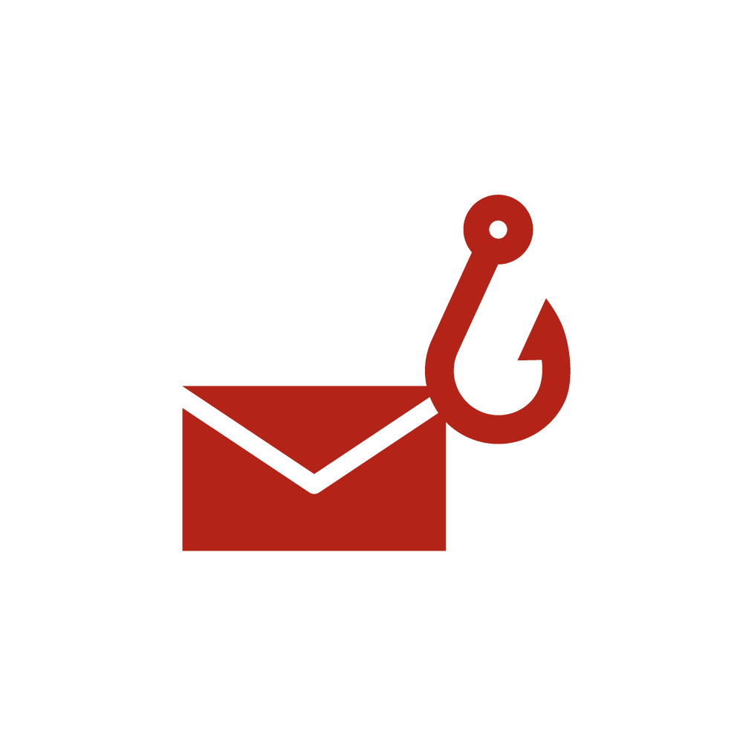


Business Email Compromise Scams Are Preying on Users
Simple Concept
Difficult to Block
Large
Financial Losses
Email sent from CEO requesting large money transfer or sensitive data
Low volume emails with generic content and no malicious code or links
Belgian Bank lost $76M due to Business Email Compromise
2400%
Increase in BEC attacks since 2015
Source: FBI Public Service Announcement, I-050417-PSA (May 4, 2017)
Notes:
The latest advanced attack to enter the email threat landscape, Business Email Compromise scams, also known as “Whaling” or “CEO Fraud”, are highly crafted emails sent to recipients by fraudsters pretending to be senior executives and they leverage social engineering and urgent requests to dupe employees into carrying out large wire transfers or sending over sensitive information.
Business Email Compromise scams are simple to craft, but difficult to detect because, unlike most email attacks, they do not contain malicious links or attachments. In addition, they are typically very targeted and have little content inside the email itself. As a result, there has been an explosion in these types of attacks, with a 2400% increase in just three years, which has resulted in more than $5 billion dollars in losses.

Slide 23
Anatomy of a Business Email Compromise Scam
Impersonated User
Impersonated Domain
From: joe_ceo@symanlec.com
To: Finance, Accounting or HR user
Subject Line: Request
Targeted User
Simple Subject Line
I need you to process a wire transfer today. Please confirm so that I can forward you the instructions.
Regards
Joe CEO
Chief Executive Officer
Sent from my iPad
Urgent Request
No Attachment or Link
Social Engineering
Notes:
Let’s take a closer look at a typical Business Email Compromise scam. With this attack, you can see that it impersonates a CEO of a company as well as the domain of a company.
Next, you can see that it targets a specific user within an organization. These users are usually within Finance or Accounting, but they could be within HR and other functions as well. This attack also has a very simple, one-word subject line, an urgent request, along with no attachment or link, which together make it seem like it’s a legitimate request coming from a top executive. It even uses social engineering tricks such as spoofing a CEO’s email signature and pretending to be sent from a mobile device to dupe the user into thinking it’s an authentic request.
Because of these impersonations and social engineering tricks, Business Email Compromise attacks are very easy to fall for and hard to block.

Slide 24

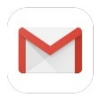

How Does Business Email Compromise Work?
Coming from a popular free email providers with good reputation and passing sender authentication
From: joe_ceo@gmail.com
Impersonation
Mail Service
Notes:
Business Email Compromise typically impersonates a user, a domain, or both a user and a domain. One approach is to send the email using free legitimate email providers with known domain reputations such as Gmail or Yahoo in order to bypass sender authentication and evade detection. Which is an example of why you need more than DKIM, DMARC

Slide 25
How Does Business Email Compromise Work?
Coming from a service with new or neutral reputation and probably passing sender authentication
Impersonation
From: joe_ceo@symanlec.com
Mail Service
symanlec.com
SPF, DMARC
checks
Creating cousin or new domain
DNS
Notes:
An even more sophisticated approach is to create cousin or new domains which appear as legitimate domains under DNS and thus are able to bypass SPF and DMARC email validation systems.. Because the domain is new, it likely passes with a new or neutral reputation and gets delivered to the end user. Attackers will start using the domains and send out emails to give the domain a neutral reputation. Bypassing email validation systems such as DMARC, DKIM, SPF is not a cure all.

Slide 26

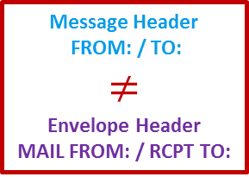
Why Does Business Email Compromise Work?
From: joe_ceo@symantec.com
To: bob_finance@symantec.com
Subject: Payment
Hi Bob,
I need you to process a wire transfer today. Please confirm so that I can forward you the instructions.
Regards
Joe CEO
Chief Executive Officer
Sent from my iPad
Message Header
From: joe_ceo@symantec.com
To: bob_finance@symantec.com
Subject: Payment
From: BECscammer@gmail.com
Mail Service
To: bob_finance@symantec.com
Message Envelope Header
Message Header FROM: / TO: $$≠$$ Envelope Header
MAIL FROM: / RCPT TO:
Users usually only sees the message header and relies on them
They will typically recognize a BEC scam when it’s too late
End User
Notes:
So, why does Business Email Compromise work? Because message header – the From, To aliases the email receiver reads does not have to match the message envelope From, To email aliases allowing the scammer to send an email from it’s legitimately created domain but craft a different From email alias as depicted here. The user usually sees the message header (not the envelope header) and relies on them for determining legitimacy. Thus, the user typically recognizes a BEC scam when it’s too late.

Slide 27
Best Practices
3

Slide 28
Best Practices for IT & IT Security
Use strong email security to block email impersonation attempts
Train your users to recognize BEC attacks through awareness & education
Register and protect your email domains as well as typosquatted domains
Leverage sender authentication typosquatted domains. Prohibit emails that use these domains via SPF hardfail and DMARC reject policies
Flag external messages
Drawbacks: When every message is being flagged, users may stop paying attention to these alerts
Use two-factor authentication for initiating wire transfers
Leverage DLP capabilities to prevent sensitive data from being shared over email with unauthorized users (i.e. W2 information sent to scammers)
Notes:
So, what are several best practices for defending your organization from targeted attacks such as BEC?
It begins with investing in strong email security with built in technologies designed specifically for blocking email impersonation attacks.
Train your users to recognize BEC attacks through awareness and education. Many phishing readiness tools exist on the market to help organizations assess, train, and benchmark their users.
Use an email security solution that includes DMARC, SPF and DKIM email validation systems Some implementation is required and experts in this area can assist. And, register and protect not only your email domains, but typsquatted domains as well using SPF hardfail and DMARC reject policies
Flag external messages to enform users to use caution when working with these emails.
Enforce the use of two-factor authentication when executing wire transfers
Implement data loss prevention measures including policy based encryption of emails containing sensitive information from being shared with unauthorized users.

Slide 29
Best Practices for Users
Question any emails requesting actions that seem unusual or aren’t following normal procedures
Do not reply to emails that seem suspicious. Obtain the sender’s address from the corporate address book and ask them about the message
Report suspicious or obviously bogus emails to the proper authorities
Notes:
Several best practices we recommend sharing with your end users include:
Questioning emails that request taking an action that seems unusual
Do not reply to emails that seem suspicious or differ from normal procedure.
Reporting to IT any suspicious emails.

Slide 30
The Symantec Solution - Business Email Compromise
4
Notes:
So, I would like to take this opportunity to share a short introduction to Symantec’s email security solutions which includes the latest threat prevention technologies to address the advanced threats we just covered.

Slide 31













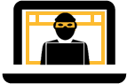





Symantec Email Security Solutions
Cloud-Based or On-premises Appliance
Data Protection
Policy-Based Encryption
Solution Overview
Advanced Threat Protection
Protects against targeted attacks, ransomware, spear phishing & business email compromise
Provides deep visibility into targeted attacks and accelerates remediation
Delivers formalized phishing awareness and training
Controls sensitive data and helps meet compliance & privacy requirements
Inbound/Outbound
Messaging Gateway
Inbound/Outbound
Users
On-Premise or Cloud
Email Server
Firewall
Third-Party
Email Server
Phishing Detection
Phishing Awareness
Anti-Spam
Anti-Malware
File
IP & URL
Senders & Recipients
Advanced Email Analytics
Threat Context
Malware Behavior
Over 60 Data Points
ATP Platform
MSS
Notes:
Symantec addresses customer challenges with either a cloud or an on-premises solution. Both of these solutions include anti-spam, anti-malware, and advanced threat protection technologies to block sophisticated ransomware, spear phishing and BEC attacks.
If an attack happens, These solutions also provide deep visibility and reporting into targeted attacks capturing over 60 data points which helps accelerate detection and remediation.
This data can be streamed into 3rd party SIEM tools and leveraged by Symantec Managed Security Services for in-depth analysis and correlation.
We offer an online phishing readiness service to help with user awareness and training
These solutions also integrate with Symantec’s Data loss Prevention and encryption solutions to help with compliance and privacy requirements.

Slide 32
Symantec Cloud Email Security Has Comprehensive Protection Against BEC Attacks
Impersonation
Stop BEC Email
Sender Authentication
Business Email Scam Analyzer
Impersonation Controls
Detection Controls
Validation of SPF, DKIM and DMARC
Advanced Heuristics
Typo Squatting
Spoofed and Phishing Domain Intelligence
User Impersonation
Domain Impersonation
Advanced Email Security Analytics
Reports/Logs
API Datafeed
Notes:
Symantec email security offers comprehensive protection against BEC attacks.
Several detection engines are utilized to block BEC beginning with essential sender authentication that validates SPF, DKIM and DMARC rules.
A business email scam analyzer uses advanced heuristics, typosquatting analysis, and spoofed and phishing domain intelligence to uncover BEC email.
And user and domain impersonation controls provide an additional layer of BEC detection.
Provide visibility in into BEC attacks with reports and logs.

Slide 33
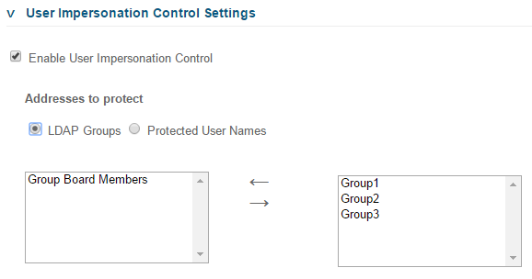
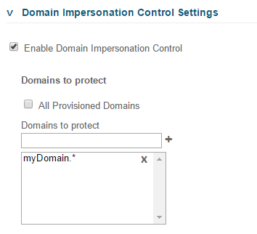
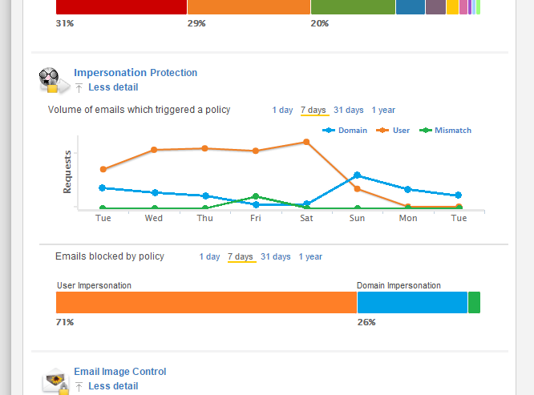
Symantec Stops BEC Scams with Strong Impersonation Controls
Block Business Email Compromise and other spoofing attacks with impersonation controls
Protect specific executives or all users from attacks impersonating a user
Stop attacks that impersonate email domains
Whitelist specific users, domains, and IP addresses
Notes:
Something new Symantec has introduced that is very powerful is automated impersonation controls which are a set of policies that detect Business Email Compromise scams. These controls identify and prevent BEC scams by using a sophisticated impersonation engine to sniff out attacks that masquerade as a specific user or spoof a legitimate email domain. This includes the ability to set policy rules specifically for certain senior executives or email domains as well as whitelist trusted users, domains, and IP addresses. Additionally, you can get complete visibility into BEC attacks through detailed reporting on these threats.

Slide 34
Symantec Provides the Deepest Visibility into BEC Attacks
Comprehensive email analytics on both clean and blocked emails scanned by Symantec
Over 60 data points, including IOCs such as files hashes, URLs, and IP addresses
Includes Business Email Compromise data such as:
Sender & recipient information
Subject lines
Email headers
Ability to stream to any SIEM via an API-driven feed
Category | Key Data Points
Clean Email Data | Message ID Message direction Sender/recipient information Subject line Email domains Attachment info (name, file type, size, file hash)
Malicious Email Data | File hashes URLs Targeted attack information Detection methods Sandbox information Malicious behavioral indicators Network communication Detailed execution analysis
Notes:
Going deeper into advanced email security analytics, Symantec provides 60+ data points on both clean and blocked emails. This includes visibility into phishing, ransomware, and Business Email Compromise attacks with data points such as email domains, attachment information, and email headers. Moreover, this includes sandboxing information such as malicious behavioural indicators, threat risk score, network communication, and detailed execution analysis.

Slide 35
Symantec is the #1 Choice in Email Security
Most Effective and Accurate Email Security Solution
Deepest Visibility into Targeted & Advanced Threats
Strongest Data Protection Controls
Industry-Leading Service Level Agreements
Notes:
What I have shared is a short introduction into Symantec’s email security solutions and built-in technologies for twarting BEC attacks. Much more is available with our email security solutions, so if I have piqued your interest, I encourage you to learn more by visiting the email security section on Symantec.com, where you can find detailed solution information and register for an online trial. and I recommend contacting your Symantec sales rep.

Slide 36
For More Information
Please visit www.symantec.com/email
Read the ISTR: Email Threats 2017 Report
Contact your Symantec sales rep
Thank you
Yvonne Dresser
Yvonne_dresser@symantec.com
Notes:
So, this concludes the presentation and I will now open up the session to your questions.

